Slide 1
Question: Is the crystal direction with the same miller index as one crystal plane also the normal direction of the crystal plane?
c’
Crystal Cell a, b, c (011) normal direction// [011]
Crystal Cell a, b, c’ (011) normal direction ？// [011]
c
b
a
This relationship only exists in cubic system

Slide 2
Chapter 4. Crystal measurement and projection
Law of constancy of angle (面角守恒定律)
Measurement of Crystals
The spherical projection of crystals and their coordinates
Stereographic polar projection (极射赤平投影)
Wulff net and its application examples

Slide 3
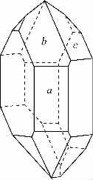
1. Law of constant angle
Practical morphologies of crystals (distorted crystals) is always deviated from those of ideal crystals.
The corresponding facial angles of crystal faces is equal although the practical crystal morphology is different and seemingly random, namely
“law of constancy of angle ”.
Significance: foundation stone for the development of crystallography
ideal a-quartz
distorted a-quartz

Slide 4
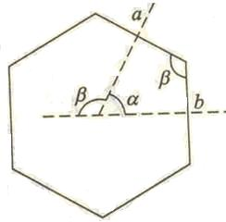
2. Measurement of crystal
Law of constancy of angle
In the same crystals, the interfacial angles of the corresponding naked crystal planes is identical.
Interfacial angle : the angle between the normal
directions of naked crystal planes.
Interfacial angle α and intersection angle β
(面角和面的夹角) The relationship between them is complementary.

Slide 5
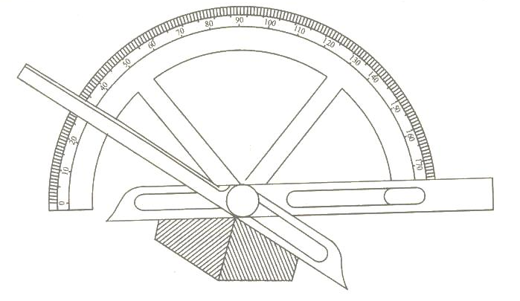
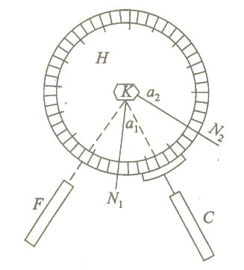
2. Measurement of crystal
Instruments for measuring the interfacial angles of crystals
Contact Goniometer
Reflection goniometer
Early and traditional methods to study the internal structure of crystals by means of crystal external characteristics.

Slide 6
3. Projection of crystal
Stereographic projection represents 3-D crystals on 2-D plane(降维处理）
As for crystals with the same structures, although the shape is different, the spherical projection points of each surface are in the same positions. （投影不依赖晶体形貌）
Notes:
Crystallographers have developed a method of graphic representation, which enables the spatial orientation of crystal planes and directions to be drawn on a piece of paper. The method uses stereographic projection and it is possible to measure stereo angles directly from the drawing.

Slide 7
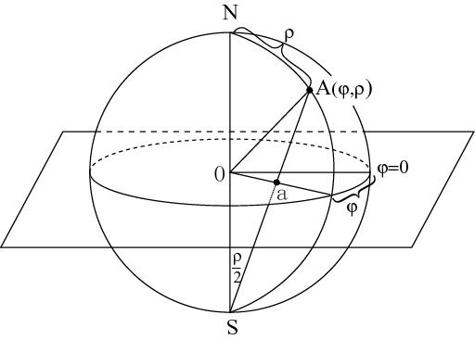
3. Projection of crystal
Projection system includes projective sphere, projective plane (equatorial plane), projection axes, North Pole and South Pole (visual point).
Projection Procedure
Projection onto the projective sphere
Projection onto 2D polar equatorial plane

Slide 8
1) Spherical projection of crystal
Make a sphere surface with the center of crystal and unit length as radius;
Then create the normal lines of every crystal surface from the center and intersect with the sphere surface at points.
These points are the spherical projection points of the corresponding crystal surfaces.
Now, planes = points. But still 3-D.

Slide 9
2) Spherical coordinates - the point label on the sphere surface
Similar to earth's longitude and latitude (Counting method is different)
Polar distance angle ρ (极距角，latitude) : the angle between the projection axis and the normal direction of crystal surface. It is counted from the north pole.
Azimuth ϕ (方位角，longitude): The angle between the meridional surface（子午面） containing the normal line of the studied crystal surface and the meridian plane of zero degree. The right east is set as ϕ=0.
The coordinates of point M on the sphere is（r,ρ, ϕ)
Projection axis

Slide 10
4. Stereographic polar projection
Project all the points on the sphere surface to the polar equatorial plane(赤道平面) with south pole (S) as view point. That is, connect the points on sphere surface with south pole point. Then the intersection point of this connection line and the equatorial plane is the point of stereographic projection.
Now, planes = points.
But 3D→2D！
e.g. Connect A, the projection point of crystal surface on sphere surface, and south pole point S. AS line intersect with equatorial plane at point a.
Thus, the distribution of all crystal faces is reflected by the distribution of corresponding points on the equatorial plane.
Notes:
equatorial
英 /ˌekwəˈtɔːriəl/ 美 /ˌekwəˈtɔːriəl,ˌiːkwəˈtɔːriəl/

Slide 11
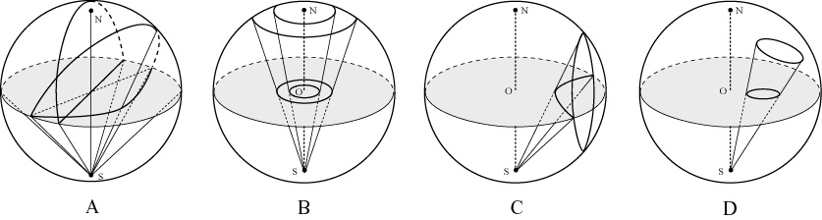
2) Stereographic polar projection
Projection ground circle
Large circle and large arc
Small circle and small arc
Large circle: a circle whose center coincides with that of the sphere

Slide 12
2) Stereographic polar projection
The projection of the horizontal large circle forms the ground circle.
The projection of the perpendicular large circle forms diameter.

Slide 13
2) Stereographic polar projection
A large circular arc is formed by the projection of a inclined large circle.

Slide 14
2) Stereographic polar projection
The projection of the perpendicular small circle forms a small arc.

Slide 15
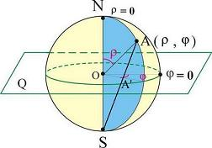
How to express the point on the surface of sphere, namely azimuth and polar distance angle?
o
ρ
ϕ= 0
h
ϕ= 0
ϕ
ϕ
A’
ϕ
ρ/2
Azimuth ϕ is measured on the ground circle and the projection of the points with the same azimuth forms a straight line in the equatorial plane; Polar distance angle ρ is shown as the distance from the projection point to the center of the circle, h = r tan (ρ /2). The projection of the point with the same polar distance angle forms a circle with the center of O in the equatorial plane.

Slide 16
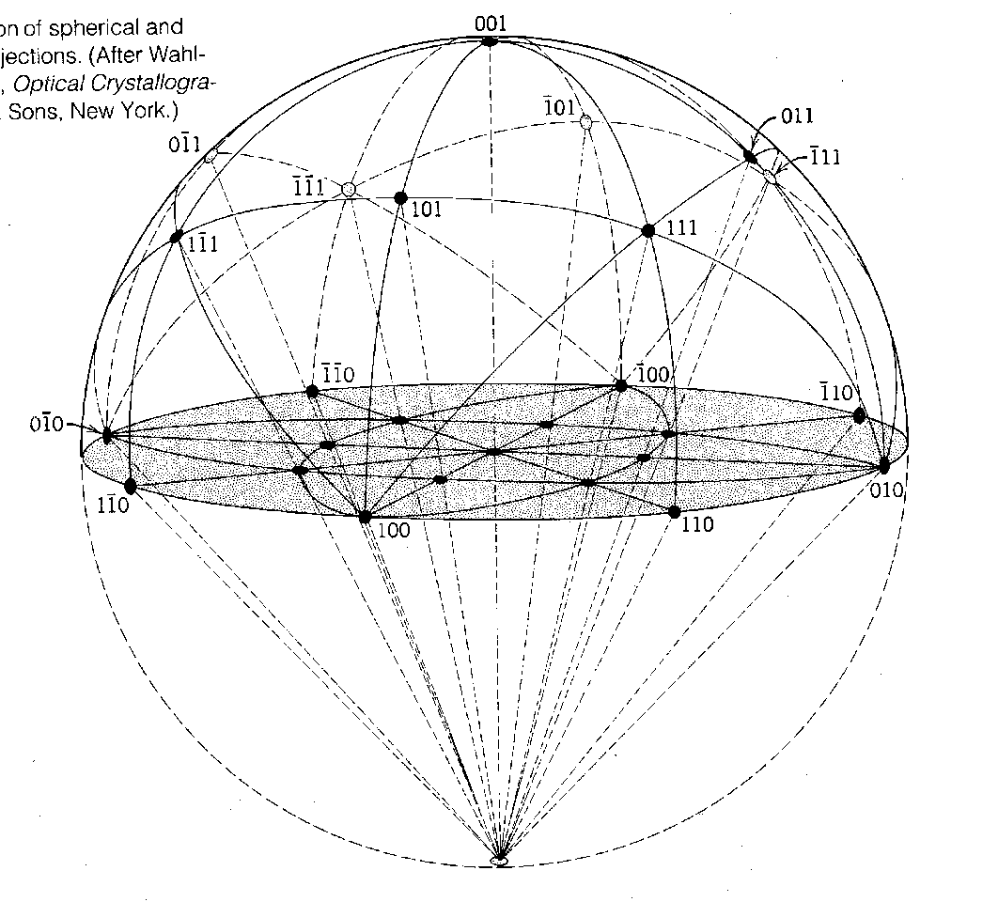
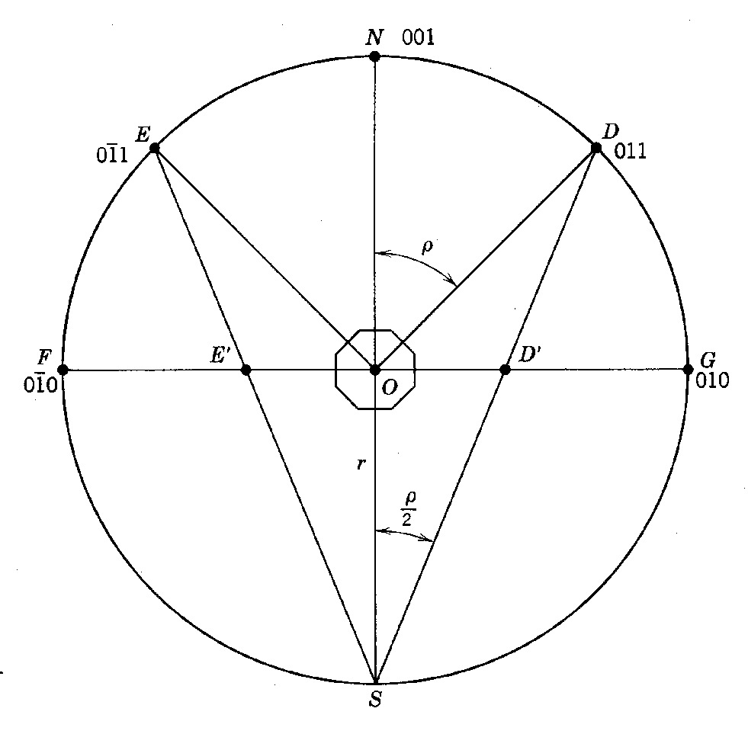
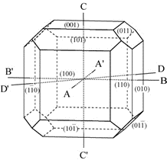
Stereographic polar projection (3D and Side view)
The projection of crystal surface on the sphere surface and its stereographic projection on the equatorial plane
A cross section of the great circle passing through the north and south poles

Slide 17
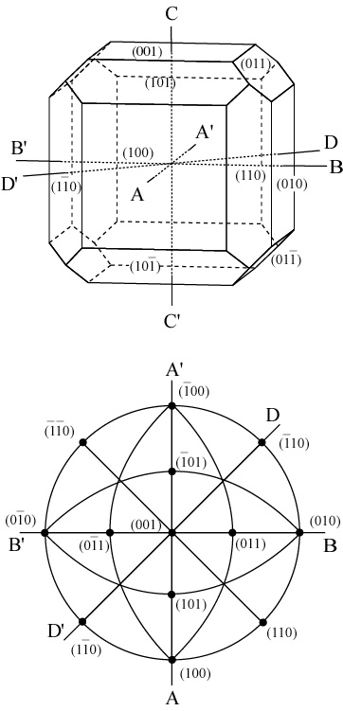
The projections of crystal surfaces of the same crystal zone distribute in a large circle.
Example: galena (方铅矿)
Projection of [001] crystal zone on the large circle of equator.
Which large circle or large arc do the [010],[100], [110] crystal zones project on?

Slide 18
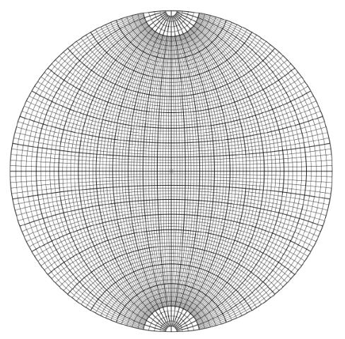
5. Wulff net and application examples
MJ：How are the earth's latitude and longitude defined?
N
Mark the scale on the projection plane (similar to coordinate paper)
Wulff net consists of ground circle, diameter, large arc and small arc.
Rules：
azimuth ϕ begins in the right east
Polar distance angle ρ starts from center O
ρ= 0
ϕ= 0
S
How to creat the Wulff net?
The “longitude （经线）" is formed by the projection of large circle through the South and North Poles, in the equidistant distribution along east-west diameter according to polar distance angle ρ .
The “latitude（纬线）" is projection from large and small circle perpendicular to North and South Axes, in the equidistant distribution along the ground circle according to azimuth ϕ .

Slide 19
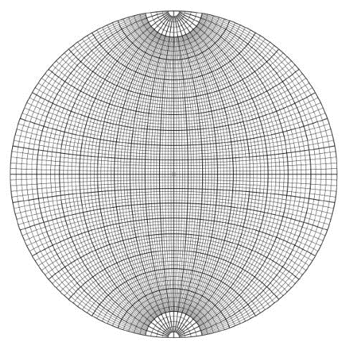
Angle gauge of spherical coordinate：
Scale on the ground circle is used to measure azimuth φ, 360° per round;
Scale on the left and right diameter is used to measure polar distance angle ρ, from circle center to ground circle with ρ from 0°to 90 °;
Scale on its large arc is used to measure the facial angle of crystal planes.
Do the points in large arc have
the same polar distance angle? No
N
ρ= 0
ϕ= 0
S
Do the points in small arc have the same azimuth φ? No
Notes:
For instance (the green points in the right figure )
It is not directly used like system of rectangular coordinates.

Slide 20
Wulff net is a plane net, however, we should see it as a sphere. The grid is able to measure azimuth and polar distance angle of any point on the sphere surface. Thus, it is easy to get the projection on Wulff net if knowing azimuth and the polar distance angles of certain points
Conclusion ：
Stereographic projection of various circle on the sphere surface is circle or arc.
Intersective angle of large circle on sphere surface equals to intersective angle of large circle on stereographic projection.
Explanation:
Except for line and arc, there is no complex graph, retaining intersective angle of large circle on the sphere surface.
Notes:
球面上的大圆可以把其两个交点放到赤平面上，这样其投影就是赤平面上的大圆弧，大圆弧之间的交角直接从赤平面上可以读取。

Slide 21
5. Wulff net and application examples
Example I: Coordinates of M on crystal surface is ρ=30º and φ = 40º. Make the stereographic projection of M.
Method I

Slide 22
5. Wulff net and application examples
Example I: Coordinates of M on crystal surface is ρ=30º and φ = 40º. Make the stereographic projection of M.
40°
Method II
Notes:
绕中心点旋转，极距角不变。。。

Slide 23
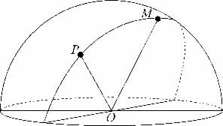
MJ：How to calculate the Angle between two directions with high school mathematics?
5. Wulff net and application examples
Example II: give the interfacial angle between the crystal surfaces M (r₁, j₁) and P (r₂, j₂).

Slide 24
5. Wulff net and application examples
Example II: give the interfacial angle between the crystal surfaces M (r₁, j₁) and P (r₂, j₂).

Slide 25
5. Wulff net and application examples
Example II: give the interfacial angle between the crystal surfaces M (r₁, j₁) and P (r₂, j₂).

Slide 26
5. Wulff net and application examples
Example II: give the interfacial angle between the crystal surfaces M (r₁, j₁) and P (r₂, j₂).
Any two points on the sphere can pass through a large circle (OP, OM determine a large circle plane);
The angle between any two points in big circle is the same as the angle between two corresponding points with the same azimuth on the large circle of Wulff net.
M’
P’

Slide 27
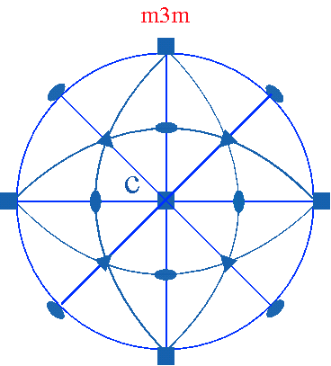
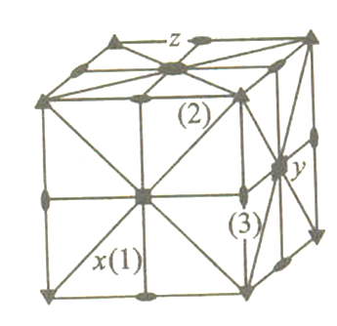
Projection of symmetry element (complement)
The projection of the pole point on upper hemispherical labeled as “⊙”, those on the lower hemisphere poles labeled as “×” ，overlap labeled as “⊙”
×

Slide 28
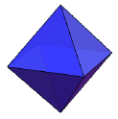
Projection of symmetry element (complement)
Octahedron

Slide 29
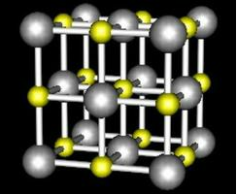
Projection of symmetry element (complement)
Galena
All the planes with low indexes are projected on equatorial plane

Slide 30
Homework
All the exercises or examples in this chapter

